Slide 1


Welcome to JobFinder!
Your pathway to successful placements
Our system provides personalized recommendations to help job seekers find the best opportunities that match their sills and aspirations, and assists recruiters in discovering talented candidates perfectly suited for their vacancies.

Slide 2
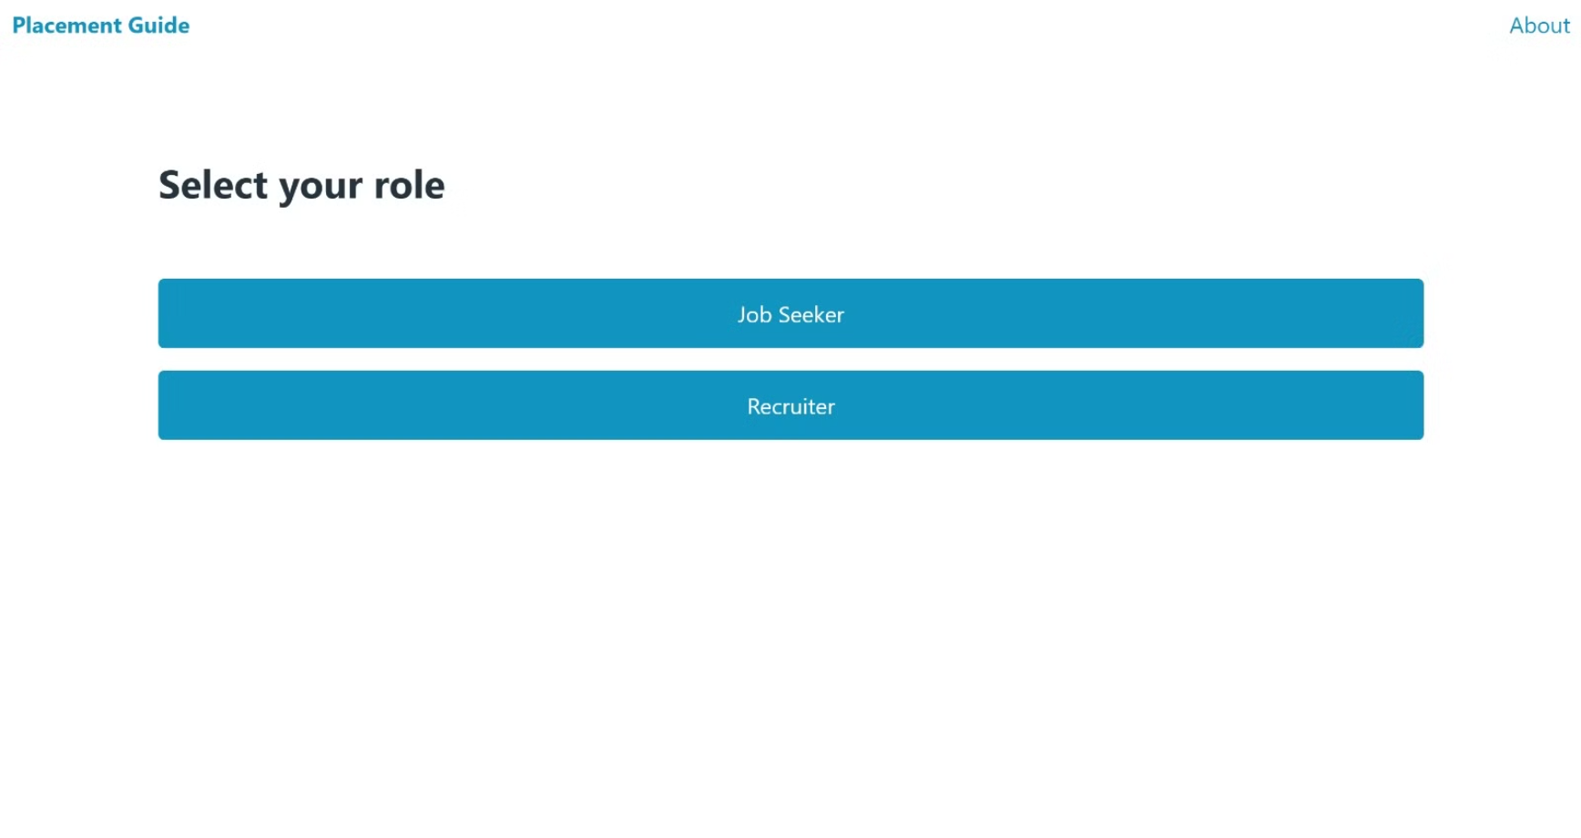

Slide 3
User Features
Sign Up & Log In
Job Recommendations
Create an account, provide information, and securely log in.
Receive personalized job recommendations based on skills and experience.

Slide 4
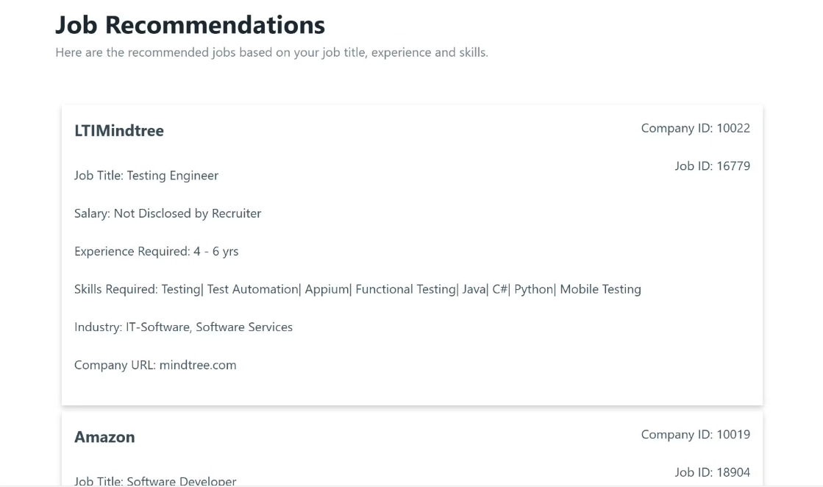

Slide 5
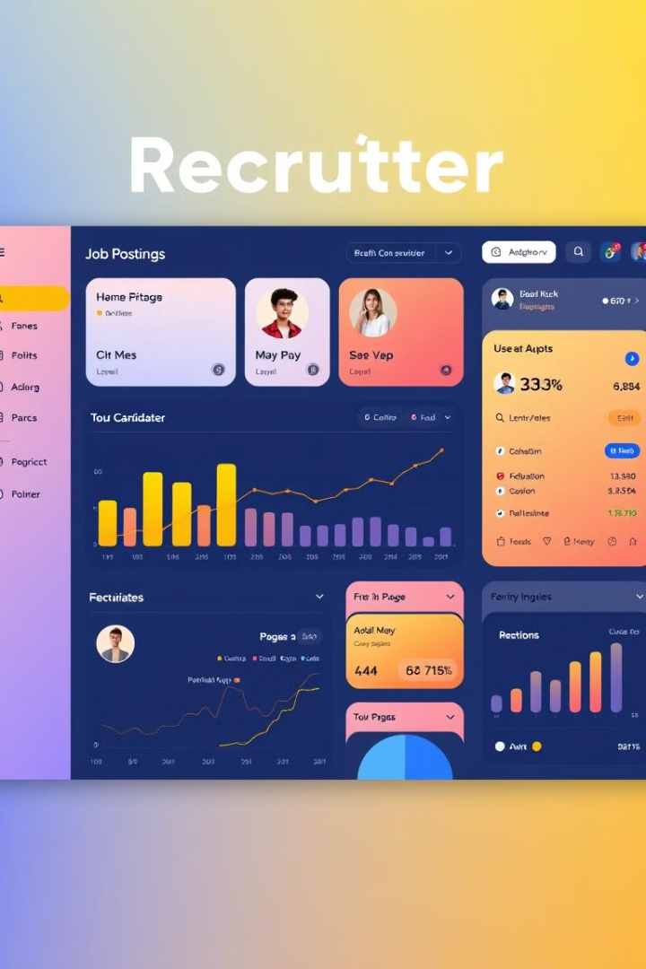
Recruiter Features
Log In
Job Listings
Recruiters access their dedicated dashboard by logging in, allowing them to manage their job postings and view candidate recommendations.
Recruiters can easily manage their job postings, ensuring a streamlined experience for attracting the right talent.
Candidate Recommendations
The system provides recruiters with a curated list of candidates best suited for their specific job postings, based on their skills, experience, and career goals.

Slide 6

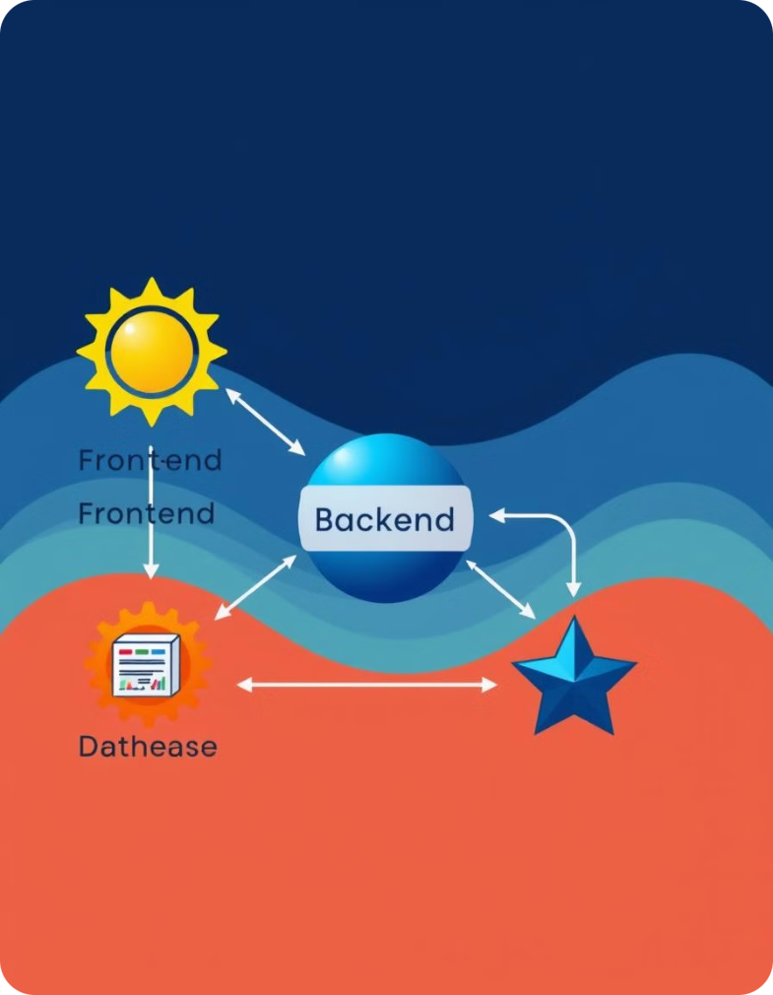




Software Requirements
Frontend
Backend
HTML, CSS, and JavaScript are used to create the user interface and provide a seamless user experience.
Python with the Flask framework powers the application's logic, handling user interactions and data processing.
Database
Data Science
PostgreSQL serves as the robust database system to store and manage user information, job data, and other critical information.
Python libraries like Pandas, NumPy, and Scikit-learn enable the development of the recommendation algorithm, ensuring highly relevant and personalized job matches.

Slide 7





Project Files
app.py
The main Flask application code.
jobs.py
The Python code containing the job recommendation logic.
jobs_info.csv
The CSV file containing the job data including job ID, company ID, - job salary, job experience, key skills, role category, functional area, industry, and job title.
companies_table.txt
Contains the SQL statements to manually create the ‘companies’ table and insert 50 companies values including company_id, company_pwd, company and domain.
templates
The directory containing the HTML templates.

Slide 8
Team Members
Varshit Fauzdar
Chetna Singh
Gargi Verma
Enrollment Number: E23CSEU0754
Enrollment Number: E23CSEU0769
Enrollment Number: E23CSEU0772

